Slide 1

Exploring Customer Behavior
A Comprehensive SQL Case Study on Database Analysis & Strategic Insight for Online Food Retailers
SUBMITTED BY: ANJALI SINHA (CX-138-MOR-JUNE)

Slide 2

Unlocking The Narrative of Data
As a Data Analyst, the most compelling task is transforming silent rows of data into a narrative that explains human behavior.
This project decodes visiting patterns and spending habits to build a deeper connection between brands and customers.
Engagement Pattern Analysis
Menu Preference Profiling
Loyalty Impact Evaluation

Slide 3

Defining Analytical Objectives
Behavioral Analysis
Financial Optimization
Track visit frequencies, identify customer entry points through "first orders," and determine menu popularity between standard and gold members.
Calculate revenue contribution per product, determine Customer Lifetime Value (CLV), and analyze annual growth trends to support operational efficiency.

Slide 4
Database Schema
The system is built on 5 core integrated tables containing 62 transactional rows and dimensional attributes.
Fact Tables:
Sales: Transaction records
Dimension Tables:
Product: Catalog & Pricing
Users: Registration master
Golduser_Signup: Loyalty tracking

Slide 5
The SQL Methodology
Data Aggregation: Leveraging COUNT(), SUM(), and AVG() to summarize workforce and transaction metrics.
Advanced Querying: Utilizing Common Table Expressions (CTEs) and Window Functions like RANK() to identify top-performing segments.
Data Transformation: Implementing CASE statements and complex JOIN logic to simulate behavior shifts and membership perks.

Slide 6
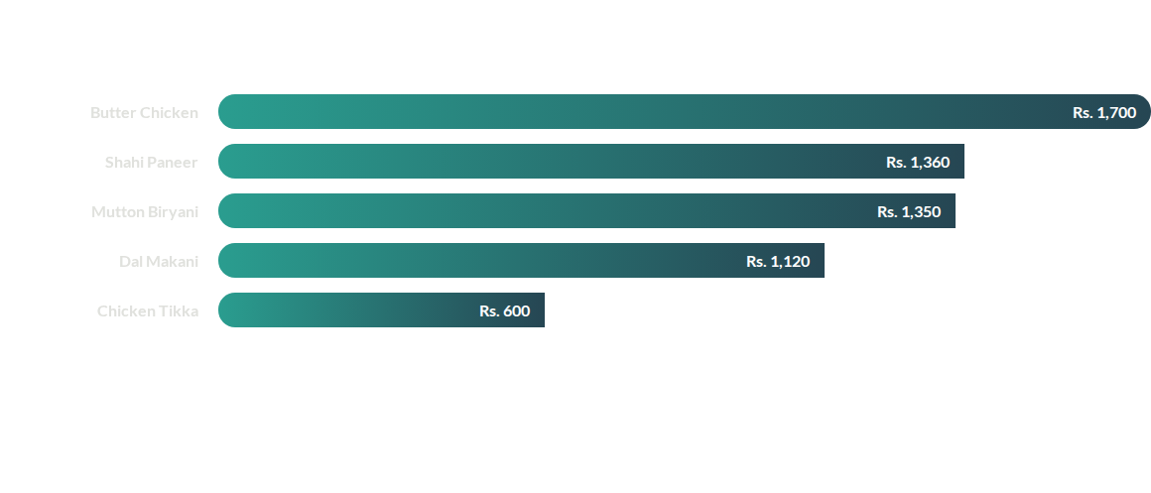
Product Portfolio Revenue
Butter Chicken dominates as the primary revenue leader, followed closely by vegetarian anchors.

Slide 7
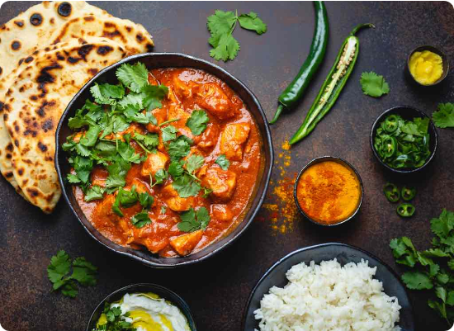
Customer "Hero" Products
Identification of high-value offerings reveals a strong preference for North Indian classics among premium members.
Shahi Paneer: Overall volume leader (8 total orders).
Dal Makani: Most common entry-point product for new users.
Premium Tier: Shahi Paneer & Dal Makani account for 15 orders within Gold users.

Slide 8
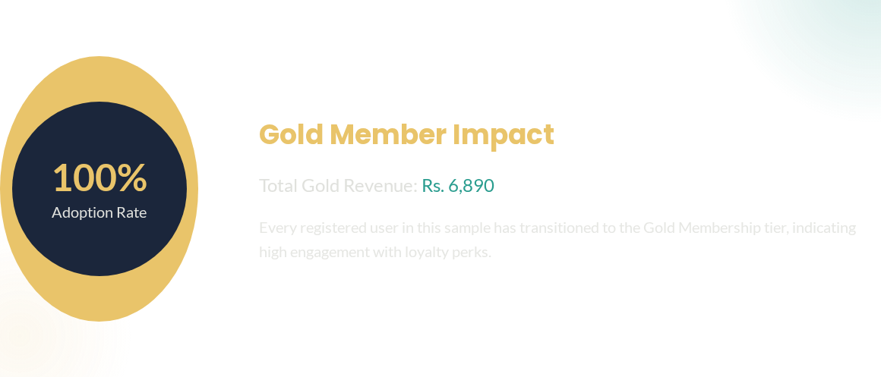
Loyalty Program Performance

Slide 9
Customer Lifetime Value Metrics
1,510
13
Max Spender (Rs.)
Loyalty Ceiling (Yrs)
User ID 1 (Anshul) leads contribution.
Users 7 & 8 show decade-long stability.

Slide 10






The Actionable Roadmap
Monetize Habits
Optimize Lifecycle
Program Expansion
Create "Gold Platters" bundling Butter Chicken & Shahi Paneer to increase Average Order Value (AOV).
Use Dal Makani as a "Welcome Voucher" for new signups to bridge the gap to Gold conversion.
Introduce a "Platinum Tier" for whales (spenders > Rs. 1000) with priority prep and zero delivery fees.

Slide 11
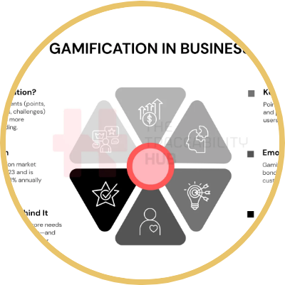
Factual Understanding Over Intuition
Through intensive SQL-based analysis, we successfully transformed transactional data into a strategic roadmap.
Proved loyalty as a massive revenue anchor.
Identified specific "hook" and "value" products.
Enabled operational readiness for non-technical teams.

Slide 12

Questions?
Exploring Customer Behavior Through Database Analysis
Anjali Sinha | Data Analyst Case Study
SQL Server Management Studio | 2024 Analysis Report

Slide 13




Image Sources
https://cdn.dribbble.com/userupload/19582538/file/original-33d2ebd1cd09396d32d635fa4fdcfbb4.jpg?format=webp&resize=400x300&vertical=center
Source: dribbble.com
https://www.conceptdraw.com/How-To-Guide/picture/Entity-Relationship-Diagram-Software-Engineering.png
Source: www.conceptdraw.com
https://onestophalal.com/cdn/shop/articles/butter_chicken_and_naan-1701754798038_1200x.jpg?v=1701756090
Source: onestophalal.com
https://thetraceabilityhub.com/wp-content/uploads/2025/09/Gamification-in-Business-updated.png.webp
Source: thetraceabilityhub.com

